Slide 1

deCode 2016 Demo
Oct 15, 2016

Slide 2

The Project
Problem: Finding statistics and making an educated prediction is difficult. What if you could collect historical data on a topic and predict the future based on that?
Example: Picking a technology to learn.

Slide 3
The Project
Solution: Build an interactive visualization tool using time series data (with predictive, correlation, and outlier) capabilities.

Slide 4
Team
Richard | Elim
Arun | Dz
Kyle | Ben
Ribaz

Slide 5
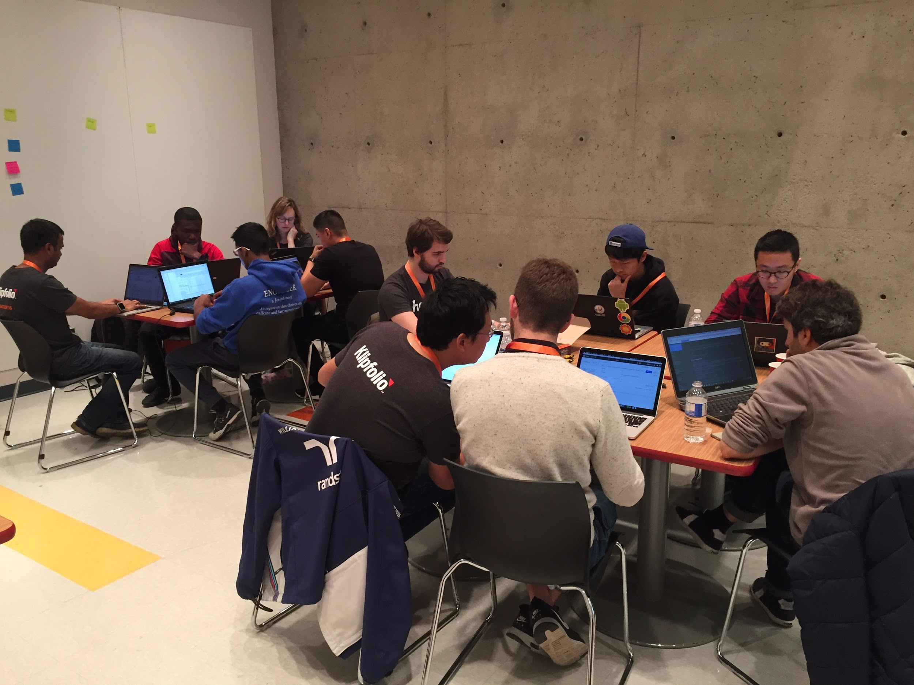
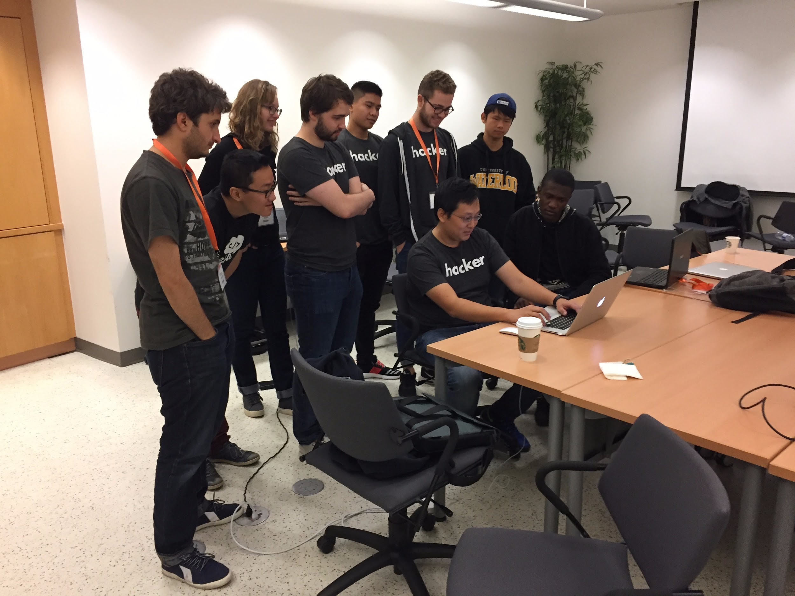
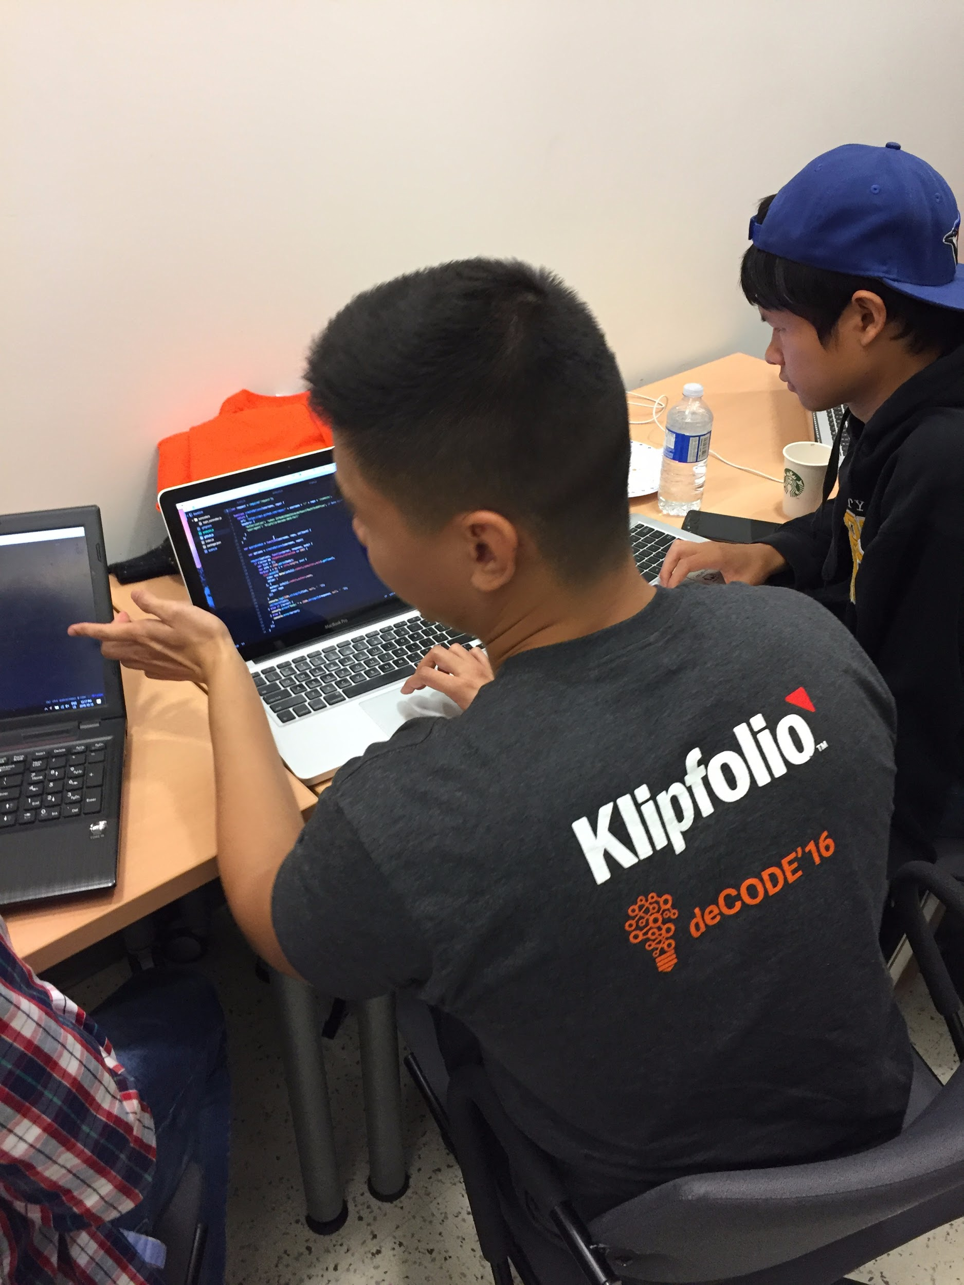
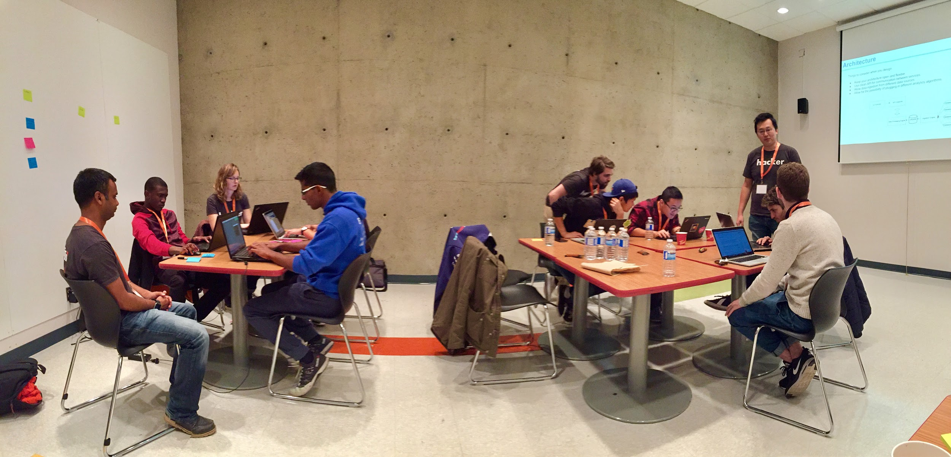

Slide 6
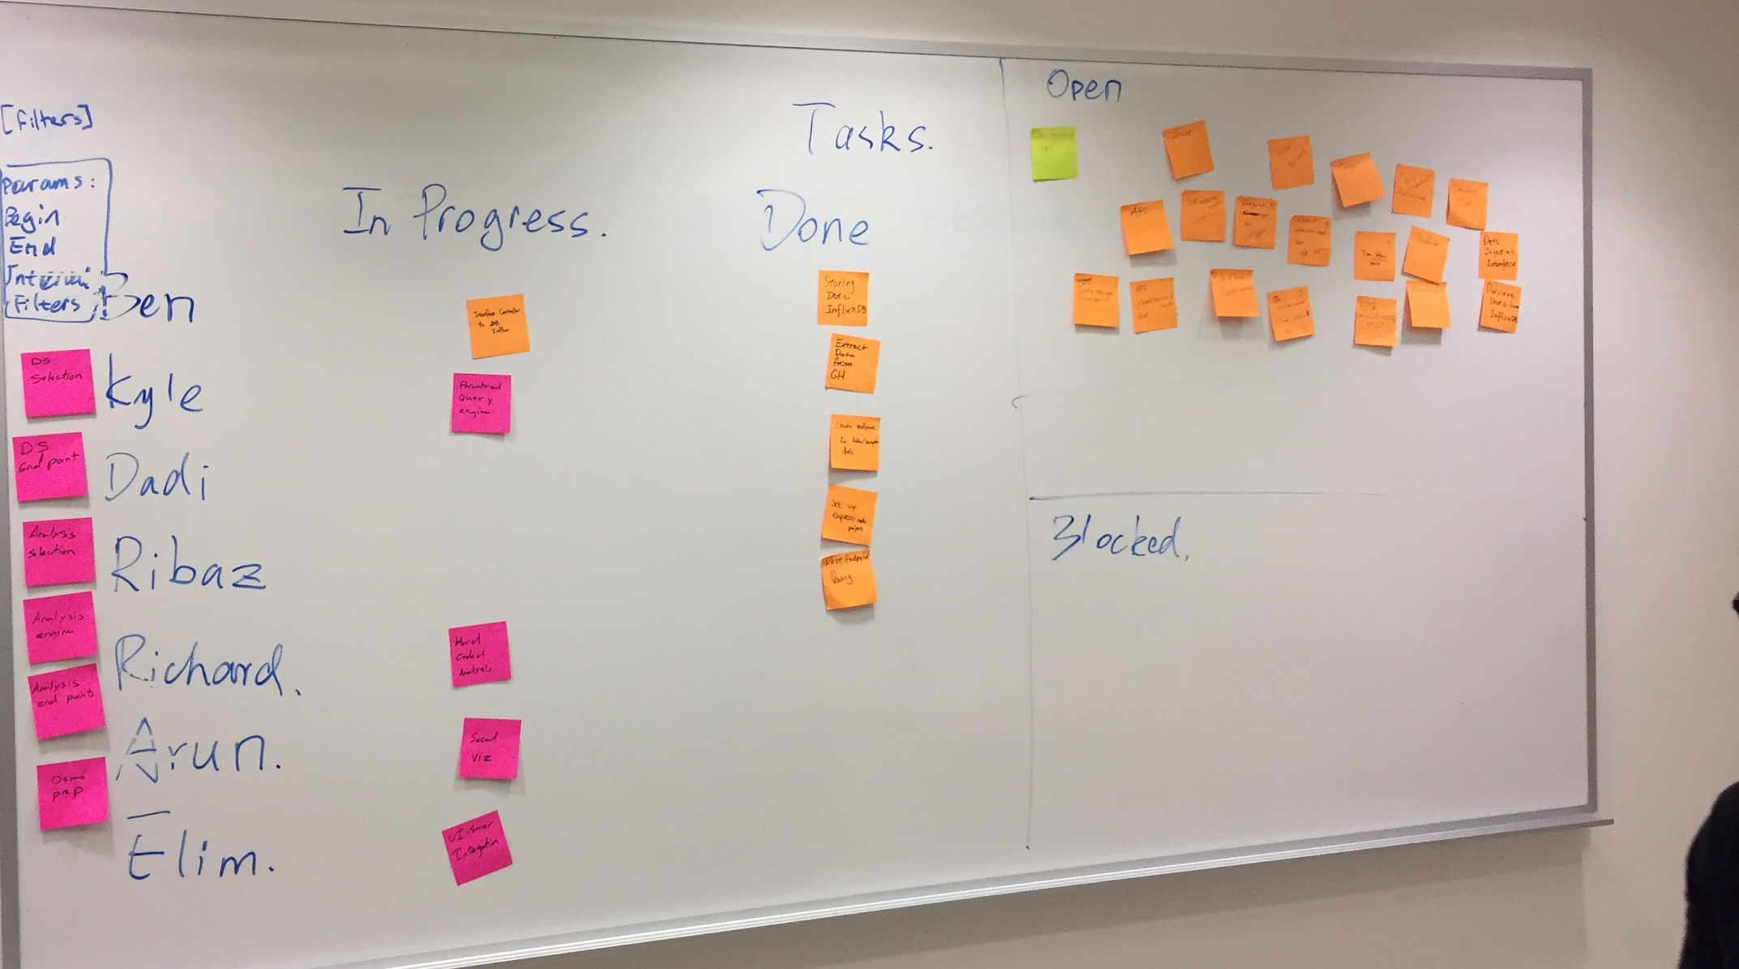
Process
Teams: two teams; front-end and back-end
Brainstorming to breakdown the tasks
Agile boards to manage the project
We did stand up meetings to organize ourselves
“Demo driven development”

Slide 7





Technology Stack

Slide 8

Technology Stack

Slide 9
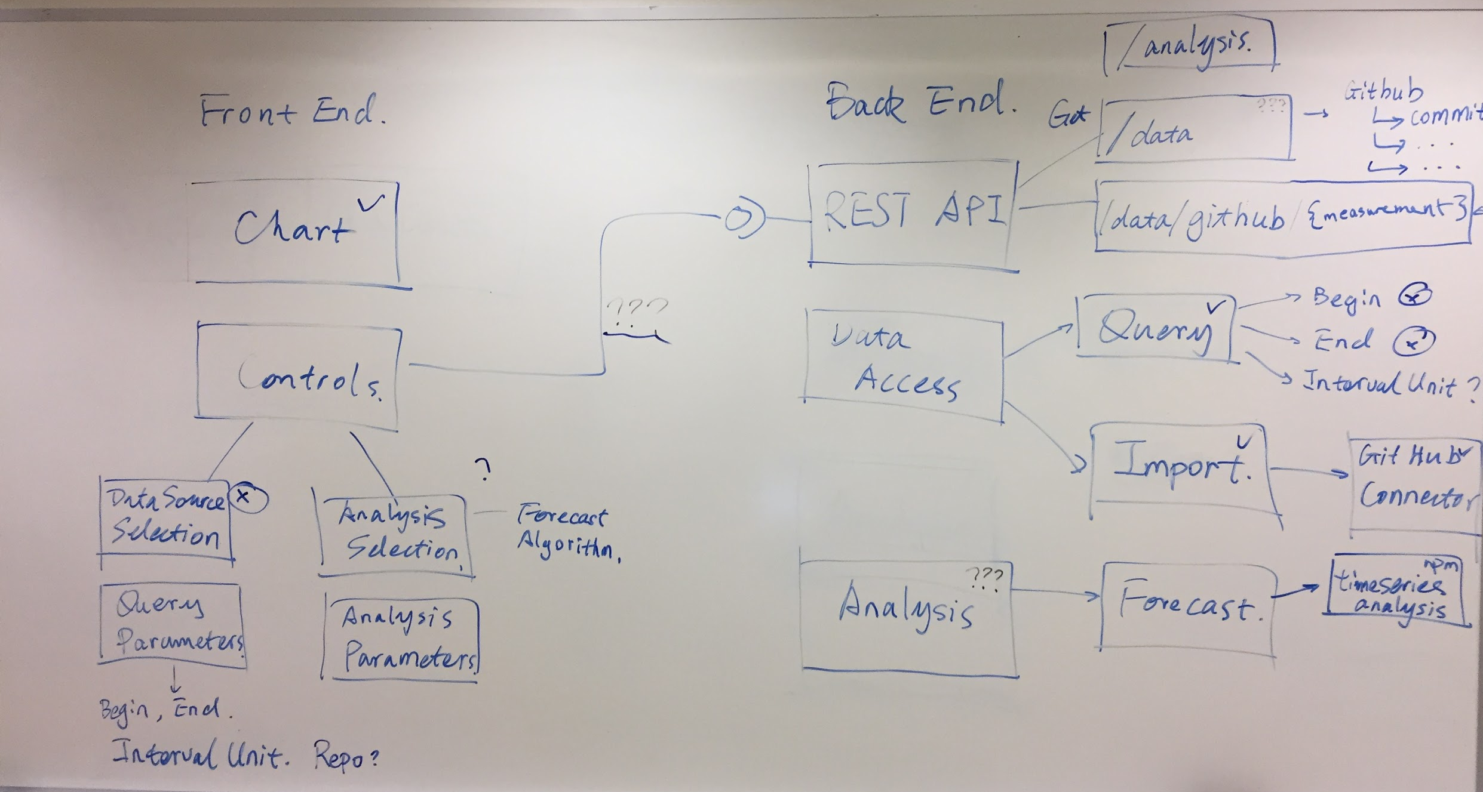

Slide 10
High level Architecture
Front End
Back End
Chart Engine
(chart.js)
REST API
(Nodejs/Express)
/data/:datasource/:measurement?params+
HTTP
Import
(InfluxDB + Github)
Github
Connector
UI Controls
(angular.js)
Ingestion/
access
Query
(InfluxDB)
Chart
Controller
Input Controller
Forecast
Analysis
Outlier
Correlation

Slide 11
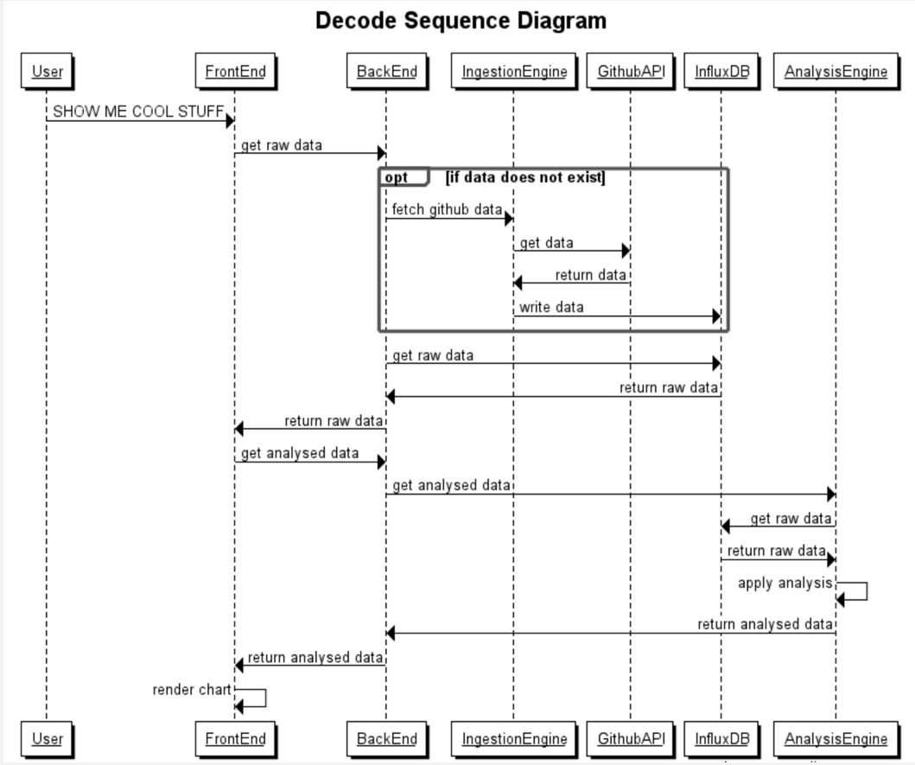

Slide 12
Live demo!

Slide 13
Q&A

